Slide 1
THE FOODIE APP
COS 101 PROJECT ASSIGNMENT
COURSE:
PROJECT TITLE:
PROJECT SUPERVISOR:
MR. BARKA FORI

Slide 2
THE FOODIE APP

Slide 3
DEFINITION
The foodie app is a user friendly and efficient desktop application designed to make food preparation easy and more efficient through provision of simple to complex recipe in a simplified manner.

Slide 4
Features:
Food search varieties
food menu recipes
Ingredients
Instructions

Slide 5
TECHNOLOGIES
PyCharm
Library
Git
VS code
API-ninja
Wikipedia API

Slide 6
FUTURE FEATURES:
Account creation system
Search based recommendations
Virtual kitchen

Slide 7
FLOWCHART
START
INPUT FOOD
IF FOOD IN API
DISPLAY FOODS
CLICK ON A SPECIFIC FOOD
DISPLAY HOW TO PREPARE SELECTED FOOD
END

Slide 8
LICENCE
This project is under MIT license.

Slide 9
APP SHOWCASE

Slide 10

LOGO

Slide 11
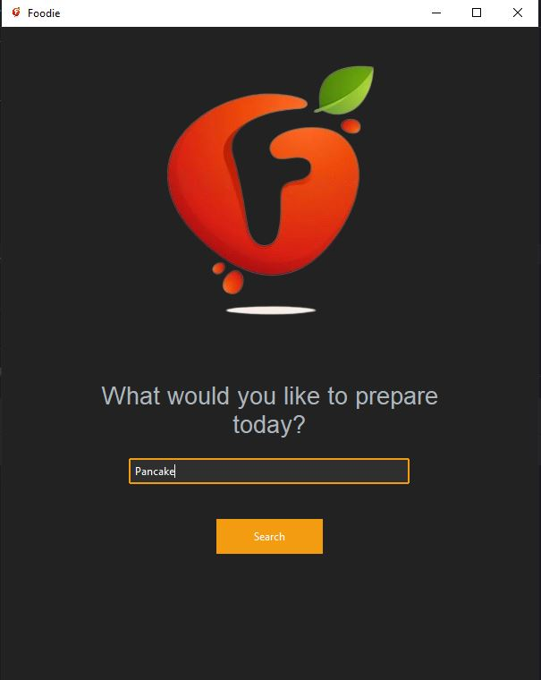
USER INTERFACE

Slide 12
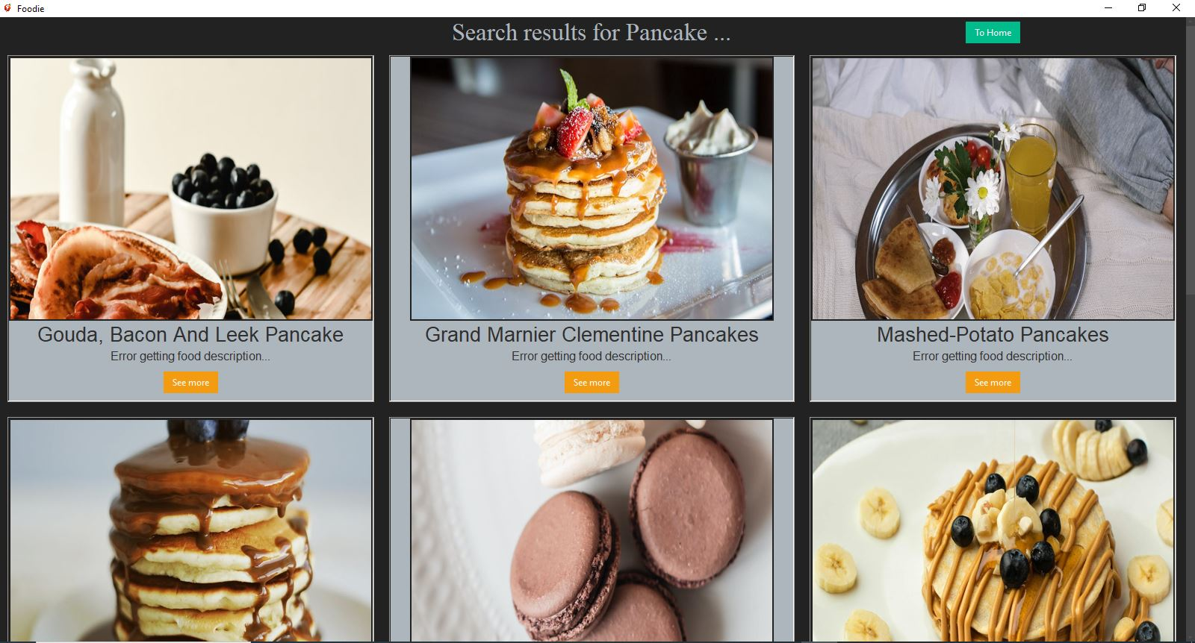
SEARCH RESULTS

Slide 13
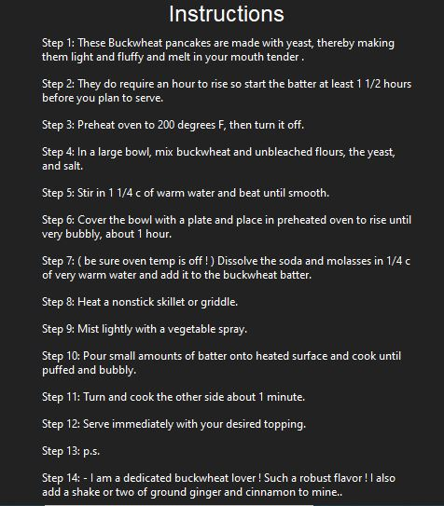
INSTRUCTIONS

Slide 14
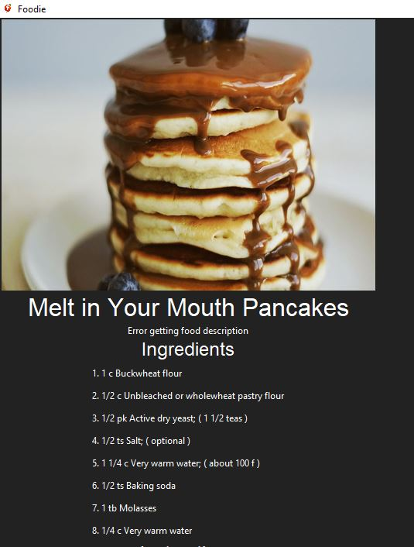
INGREDIENTS

Slide 15
AUTHORS
Maor Bemdoo ------------------------ BHU/23/04/05/0068
Elias Esther ------------------------ BHU/23/01/07/0044
Stephenie Bitram Boyi ------------------------ BHU/23/04/09/0074
Ibrahim Daniel ------------------------ BHU/23/04/05/0076
Adamu Jighjigh Desmond ----------------------- BHU/23/04/09/0080

Slide 16
THANK YOU!

